Slide 1

Retail Sales Analysis Project
QUINTET
ANALYSTS
kj

Slide 2

content
Step 1: Load and Explore the Dataset
Step 2: Data Cleaning
Step 3: Basic Sales Calculations
Step 4: Exploratory Data Analysis (EDA)
Step 5: Data Visualization
Step 6: Conclusion & Business Recommendations

Slide 3

Step 1: Load and Explore the Dataset
Data Extraction
Libraries
Pandas
Matplotlib
Seaborn
Numpy

Slide 4

Step 2: Data cleaning
Checking Missing Values
Checking Duplication
Checking Data Types
Data Convertion

Slide 5

Step 3: Basic Sales Calculations
Total Sales
Total profit
Average Sales By Order
Profit Margin Calculations
Shipping Duration

Slide 6

Step 4: Exploratory Data Analysis (EDA)
Top Selling Products
Most profitable Products
Top 5 Customers
Hunter Lopez
Tom Ashbrook
Raymond Buch
Tamara Chand
Sean Miler
-Region/States that generated the most revenue

Slide 7

Step 5: Data Visualization

Slide 8

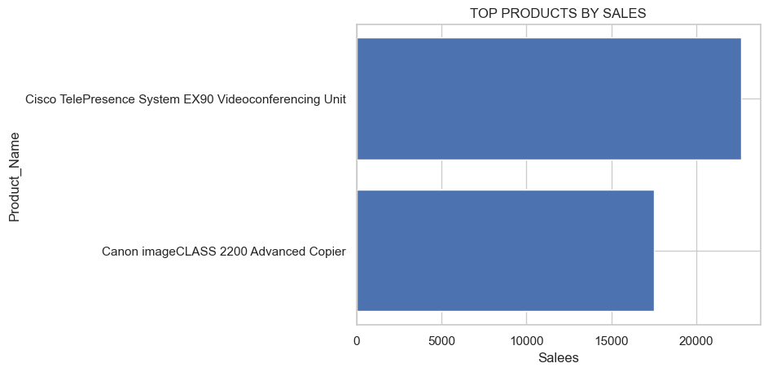
Top products by sales

Slide 9
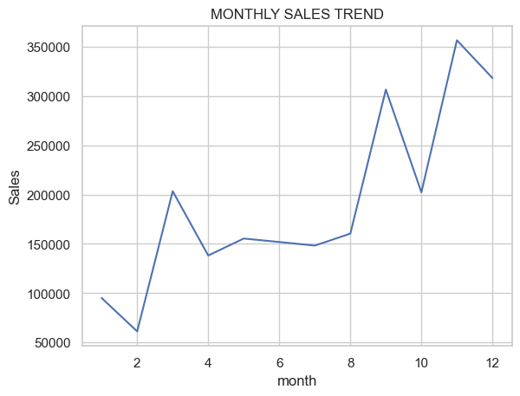
November
September
March
TOP 3 MONTHS FOR BEST SALES
Notes:
We have 3 months were the company made high sales , for a Year

Slide 10
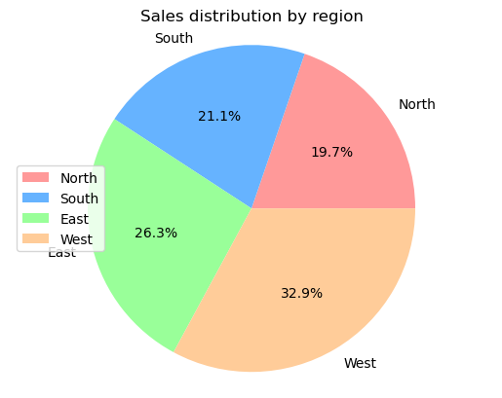
Sales distributions

Slide 11
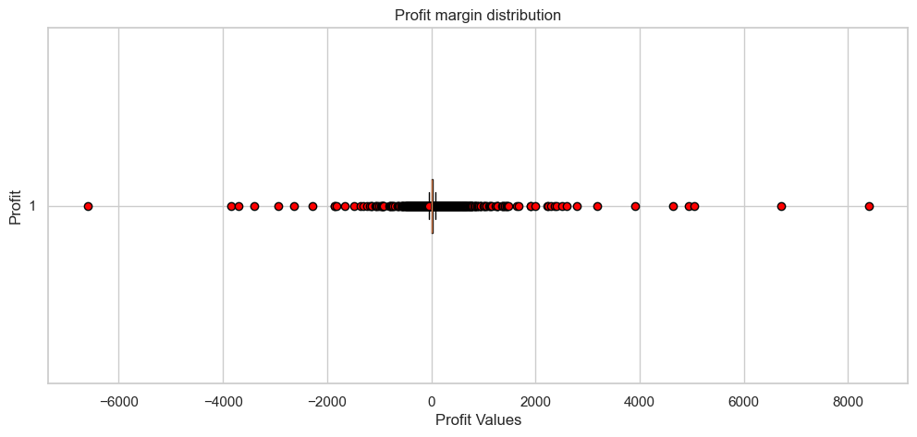
Profit margin distribution
Profit
loss

Slide 12
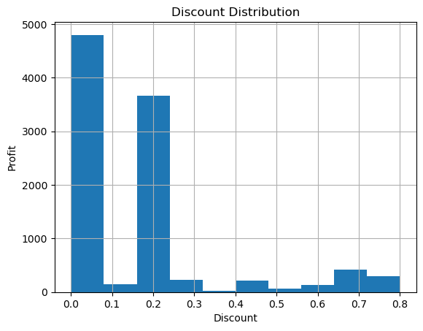
Discounts distribution

Slide 13

Step 6: Conclusion & Business Recommendations
key findings
Insights on which products/regions/customers drive the most sales.
Suggested strategies to improve profit margins and optimize discounts
opportunities to improve shipping efficiency

